Slide 1
Data Analysis and Visualization using Tableau on Diabetes Dataset
Group C: Sanjeev Kumar Jha

Slide 2
Business Understanding
The objective of the dataset is to diagnostically predict whether or not a patient has diabetes, based on certain diagnostic measurements included in the dataset.

Slide 3
Data Understanding
The datasets consist of several medical predictor (independent) variables and one target (dependent) variable, Outcome. Data understanding is necessary to familiarize with the data, to gain some understanding about the potential features and to see if data cleaning is needed. We have done this using Tableau.

Slide 4
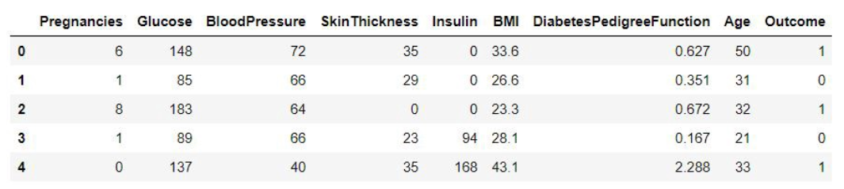
Data Understanding
Exploring and understanding the dataset below :

Slide 5
Data Understanding
Pregnancies: Number of times pregnant
Glucose: Plasma glucose concentration a 2 hours in an oral glucose tolerance test
Blood Pressure: Diastolic blood pressure (mm Hg)
Skin Thickness: Triceps skin fold thickness (mm)
Insulin: 2-Hour serum insulin (mu U/ml)
BMI: Body mass index (weight in kg/(height in m)^2)
Diabetes Pedigree Function: Diabetes pedigree function
Age: Age (years)
Outcome: Class variable (0 or 1) 268 of 768 are 1, the 500 are 0
We have observed that the dataset contain 768 rows and 9 columns. ‘Outcome’ is the column which we are going to predict , which states whether the patient is diabetic or not. 1 means the person is diabetic and 0 means person is not. We can identify that out of the 768 persons, 500 are labeled as 0 (non diabetic) and 268 as 1 (diabetic)

Slide 6
Cognitive Diagram
BMI
DBF
Skin Thickness
Insulin
Age
Glucose
BP
Pregnancies
Data Preparation
Treating 0 Values
0 values are replaced with avg values

Slide 7
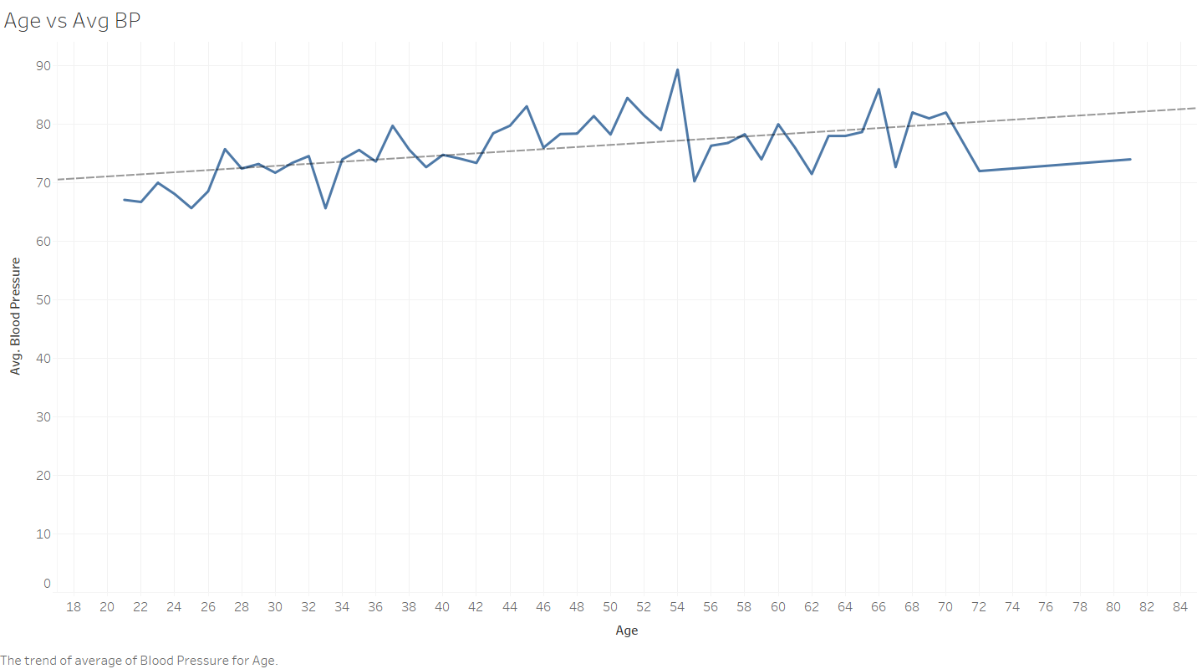
Age Vs Avg BP
There is a upward trend in avg. bp with increase in age. This is expected.

Slide 8
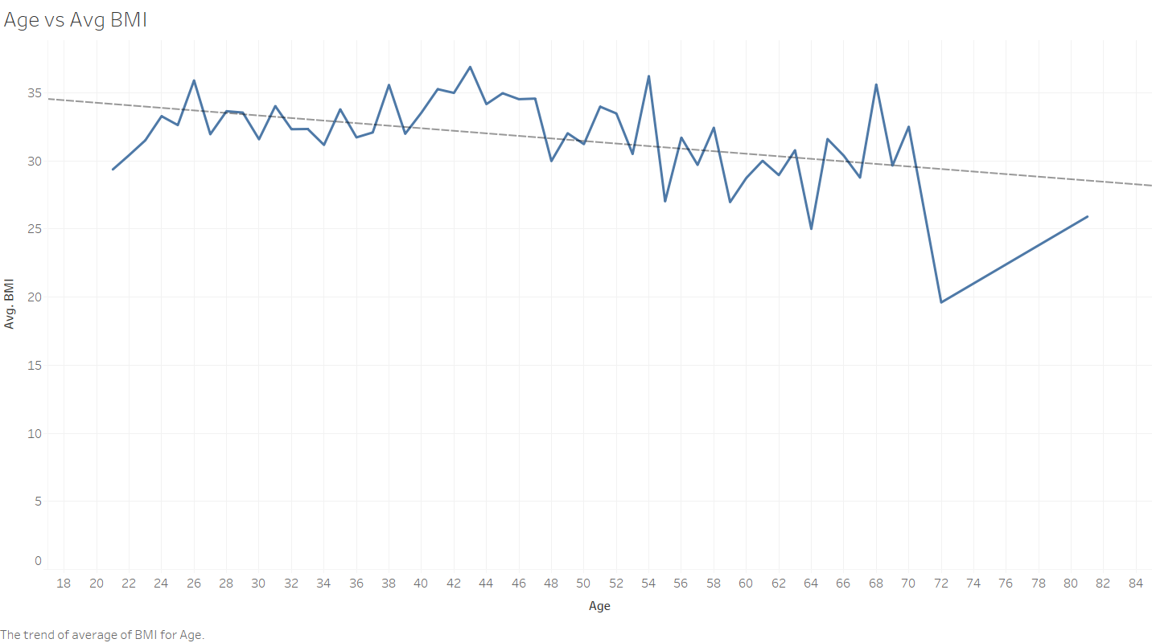
Age vs Avg. BMI
There is a downward trend in avg. BMI with increase in age. This is expected.

Slide 9
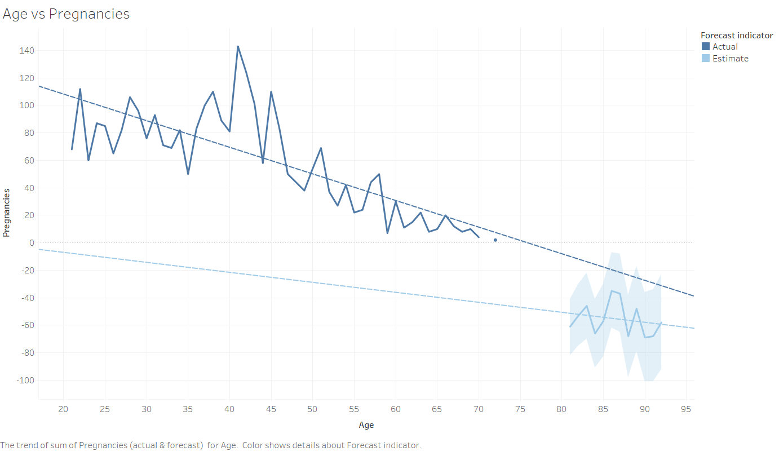
Age vs Pregnancies
There is a downward trend in number of pregnancies with increase in age. This is expected.

Slide 10
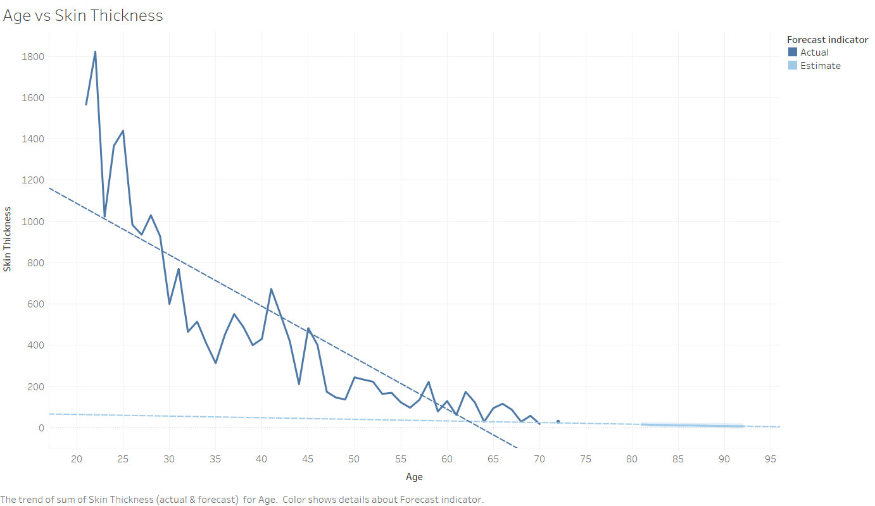
Age vs Skin Thickness
There is a downward trend in skin thickness with increase in age. This is expected.

Slide 11
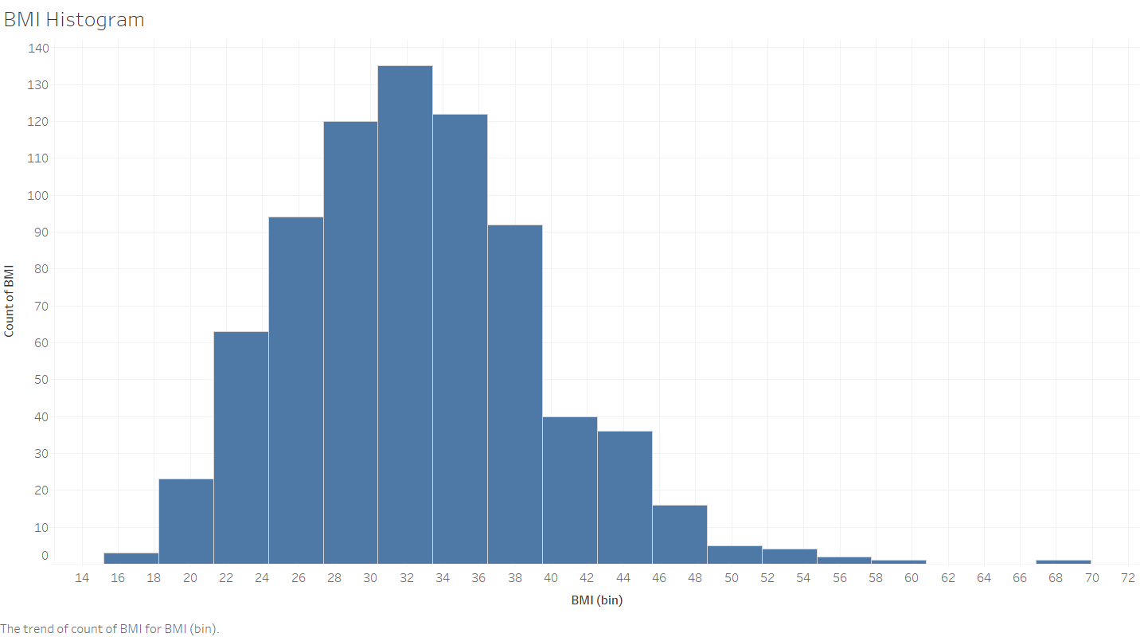
BMI Histogram
It’s normal curve with slightly right skewed.

Slide 12
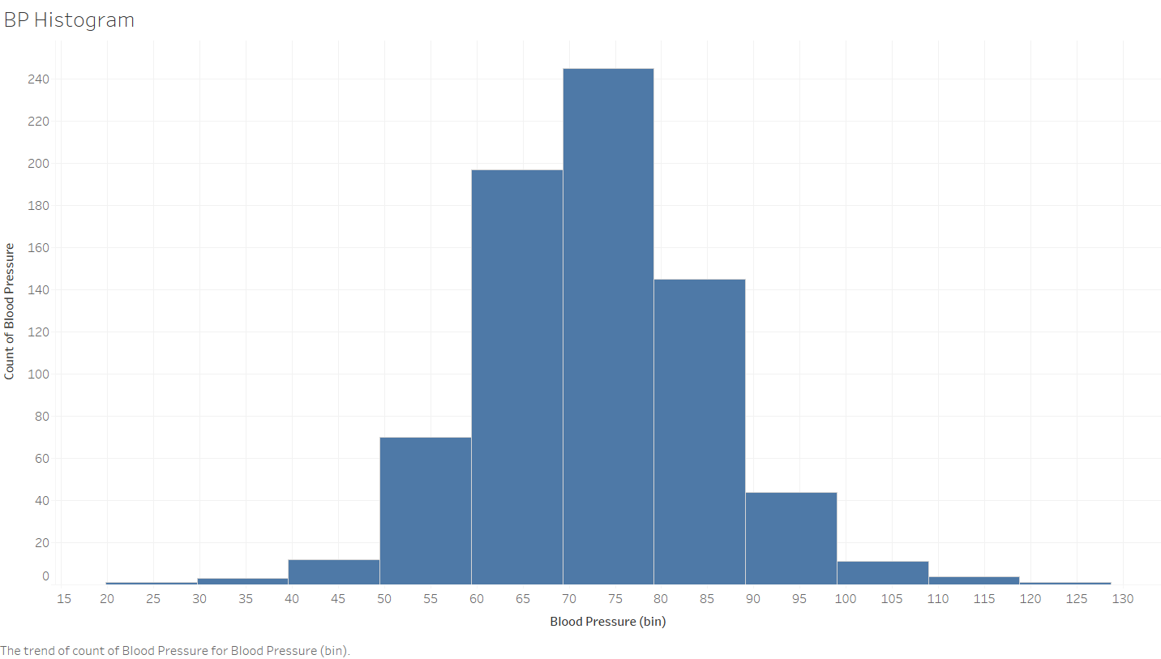
BP Histogram
It’s normal curve.

Slide 13
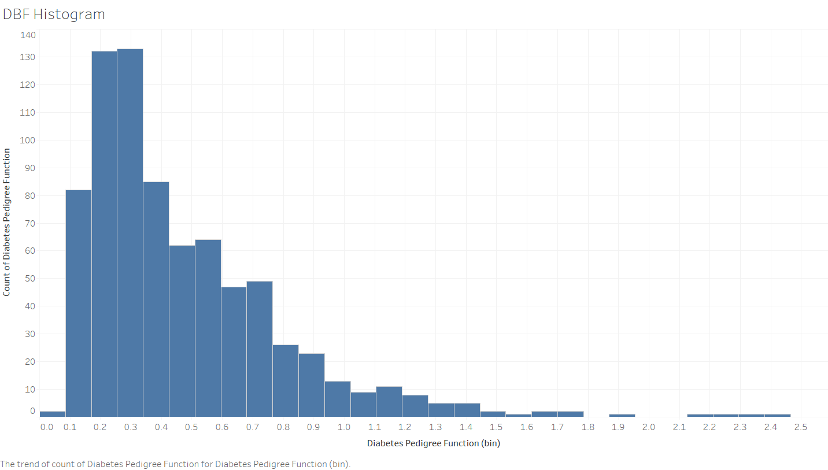
DBF Histogram
It’s normal curve with right skewed

Slide 14
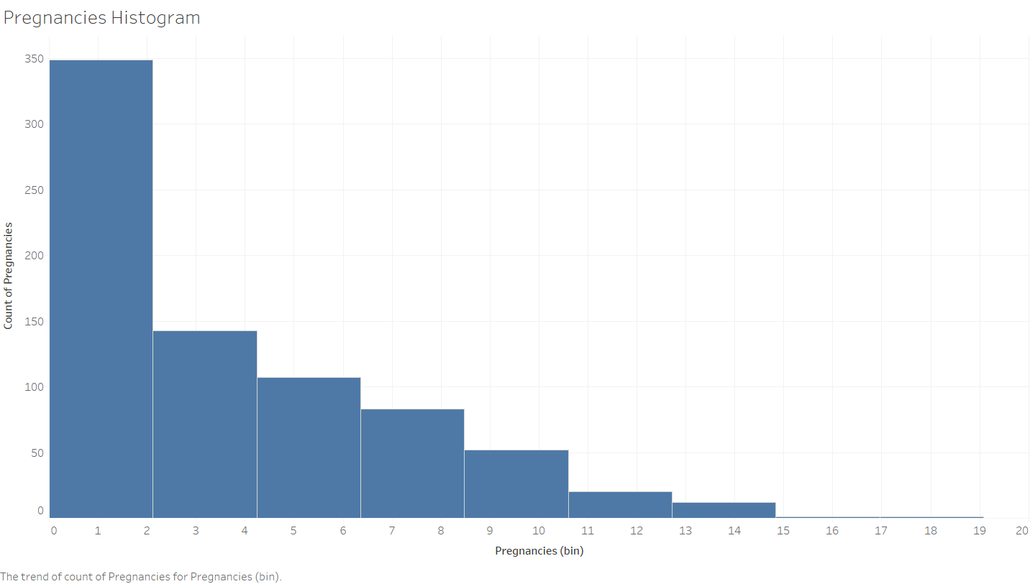
Pregnancies Histogram
It follows a negative distribution. This is expected.

Slide 15
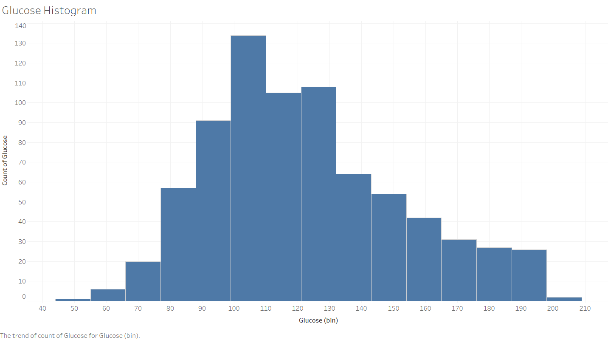
Glucose Histogram
It follows a normal distribution with right skewed

Slide 16
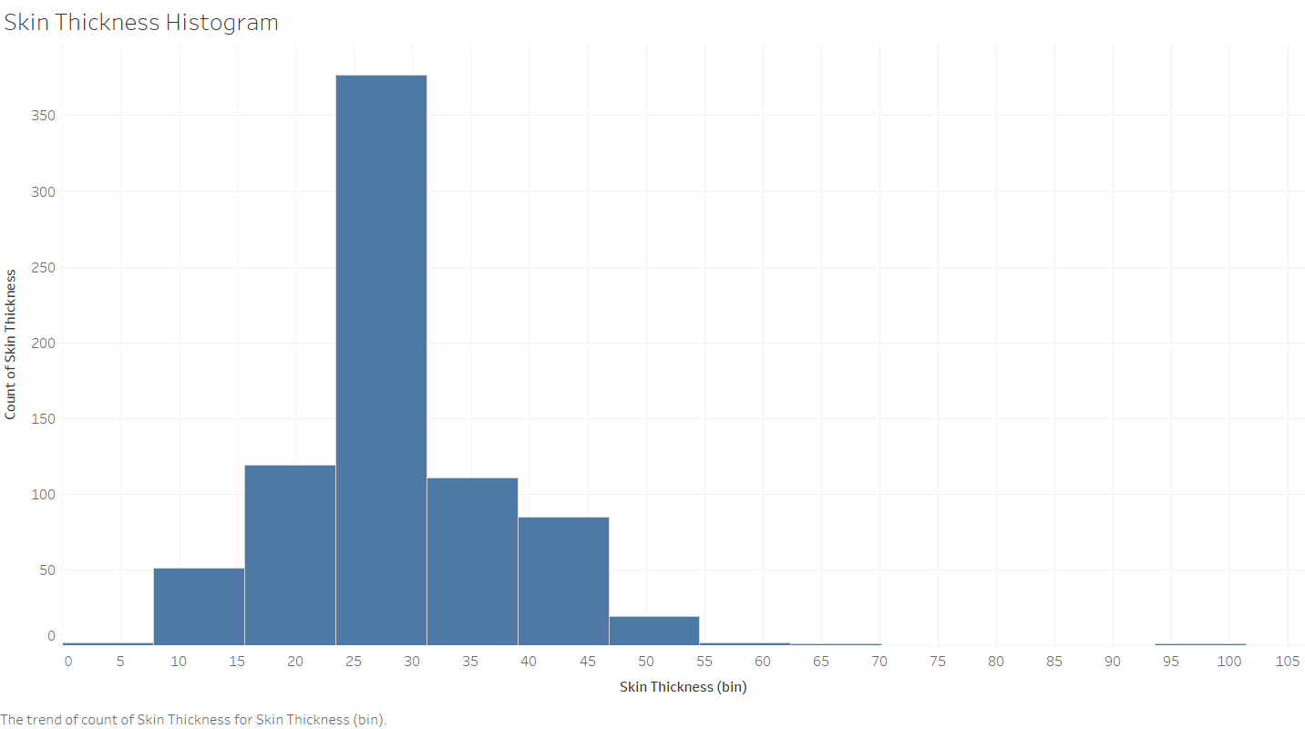
Skin Thickness Histogram
It follows a normal distribution with right skewed

Slide 17
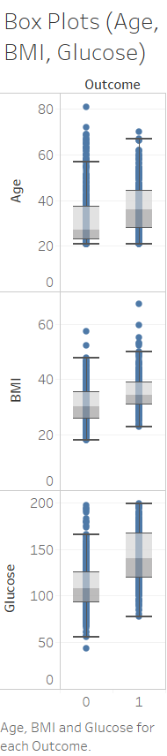
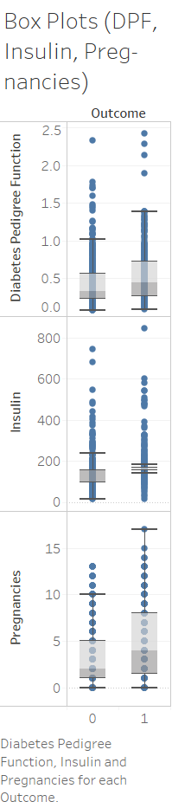
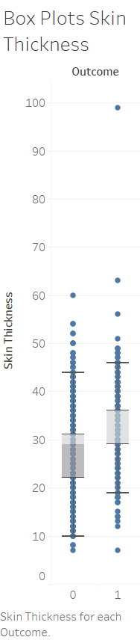
Box Plots
Median is high for all the parameters with outcome 1 when compared with outcome 0
Insulin has more outliers than any other parameters
Except for pregnancies, data for all the parameters have less spread(standard deviation)

Slide 18
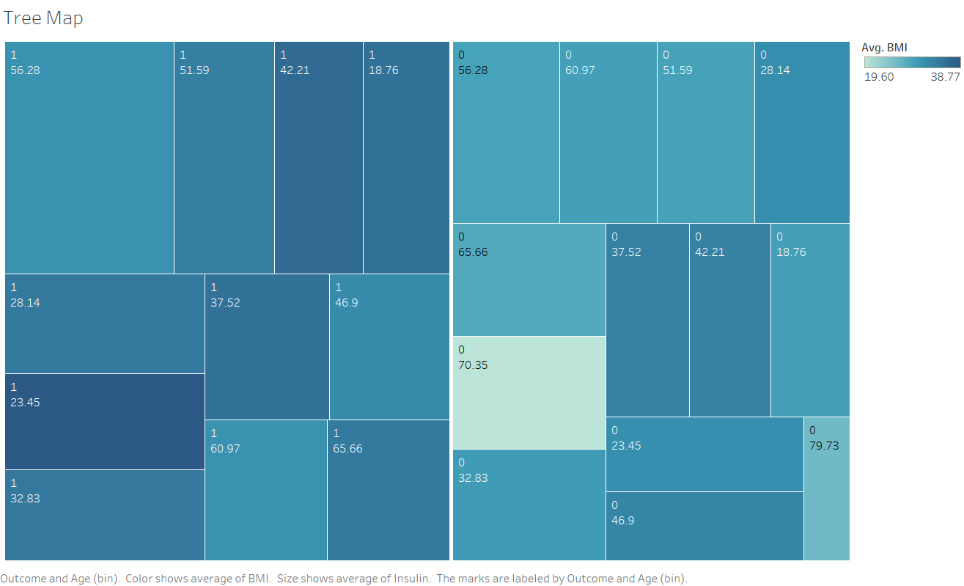
Tree Map
Most Likely to be diabetic
Avg BMI 31.24
Avg Glucose 169.25
Avg Insulin 355.4
Focus Area
Avg BMI 35.60
Avg. Glucose 141.26
Avg Insulin 181.6
Focus Area
Avg BMI 34.50
Avg. Glucose 137.76
Avg Insulin 180.1
Focus Area
Avg BMI 34.56
Avg. Glucose 137.76
Avg Insulin 203

Slide 19
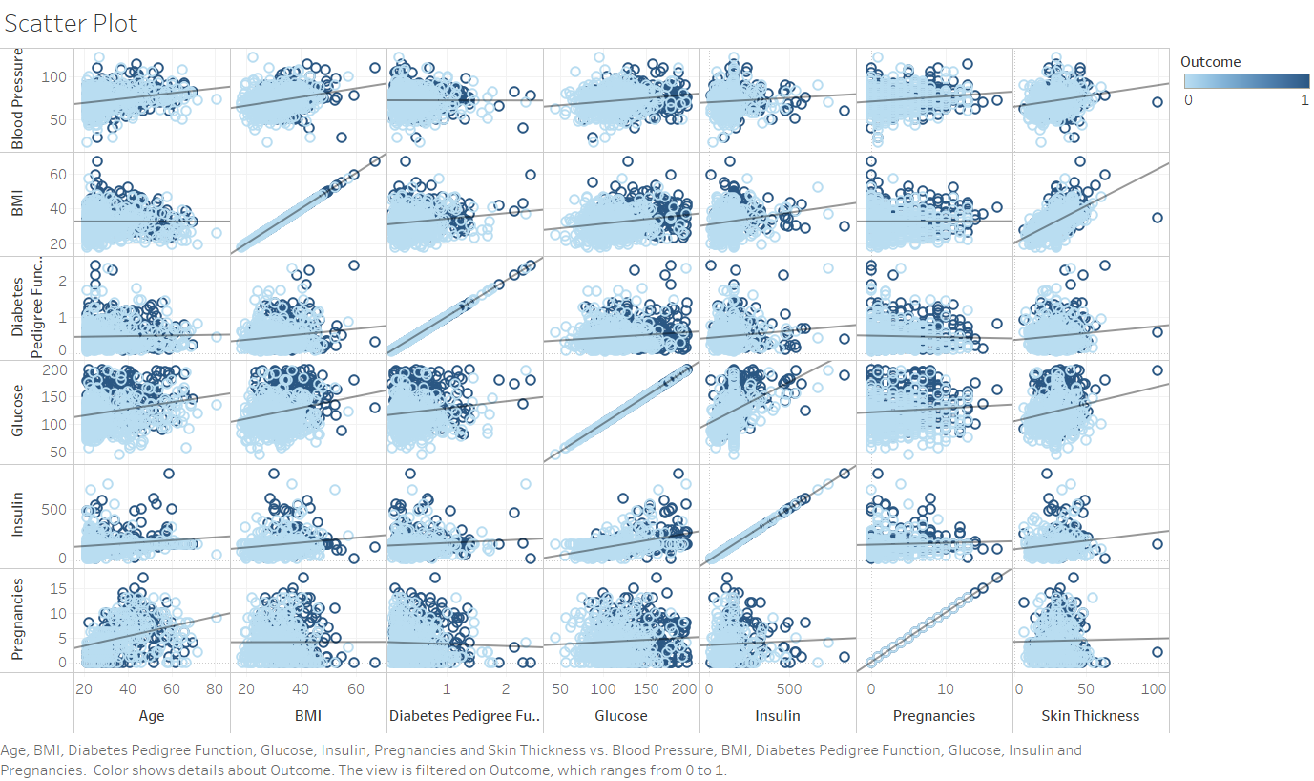
Pair Plots
Correlations exists between Skin Thickness & BMI , Glucose & Insulin

Slide 20
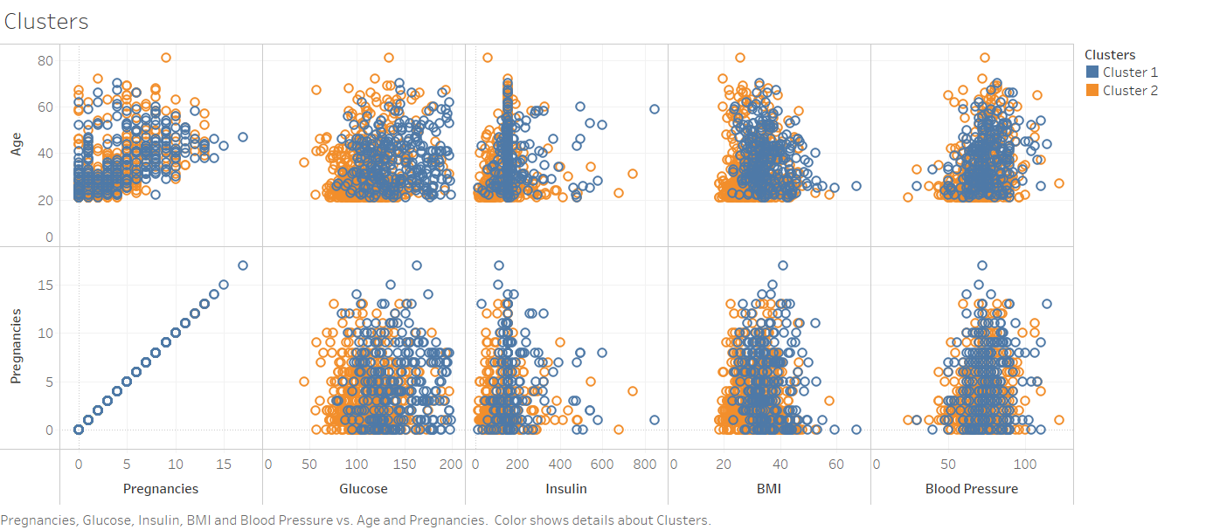
Clustering – Age / Pregnancies
No Correlations exists

Slide 21
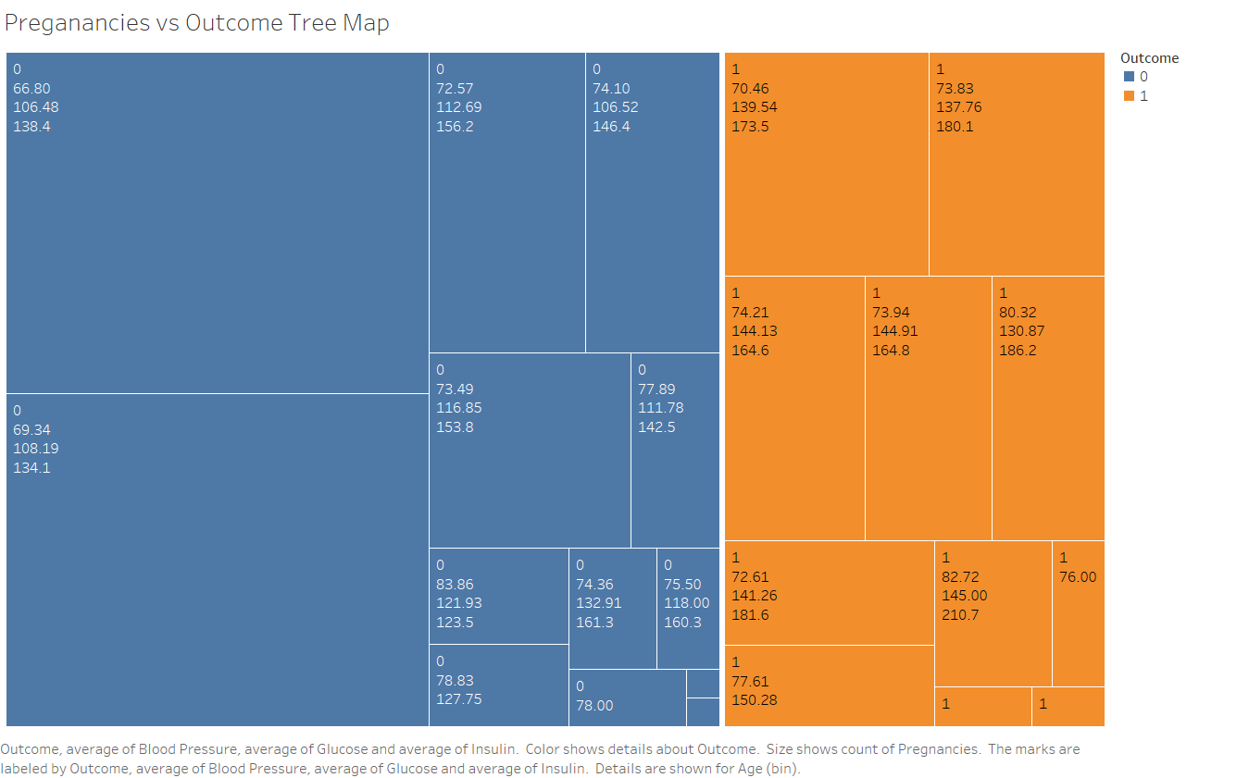
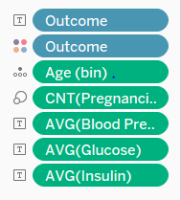
Pregnancies vs Outcome
Area of Concern
Most Likely to be diabetic

Slide 22
Observations from Data
General observation of the dataset shows that:
The pregnancies and age attributes are integers
The population is generally young, less than 50 years old
Some attributes where a zero value exist seem to be errors in the data (e.g. plas, pres, skin, insu, and mass)
Upon examining the distribution of class values, it has been noticed that there are 500 negative instances (65.1%) and 258 positive instances (34.9%)

Slide 23
Observations from Data
Reviewing histograms of all attributes in the dataset shows us that:
Some of the attributes looks normally distributed (skin thickness, and BMI)
Some of the attributes looks like they may have an exponential distribution (pregnancies, insulin, DPF, age)
Age should probably have a normal distribution, the constraints on the data collection may have skewed the distribution
Testing for normality (normality plot) may be of interest. We could look at fitting the data to a normal distribution

Slide 24
Data Preparation
Data Cleaning
There are several factors to consider in the data cleaning process:
Duplicate or irrelevant observations
Bad labeling of data, same category occurring multiple times
Missing or null data points
Unexpected outliers
Since we are using a standard dataset, we can safely assume that factors 1, 2 are already dealt with.

Slide 25
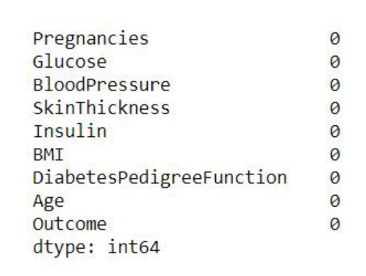
Data Preparation
Missing or Null Data points
We can find any missing or null data points of the dataset if there is any and remove.
We can observe that there are no data points missing in the dataset. If there were any, we should deal with them accordingly.

Slide 26
Data Preparation
Unexpected Outliers
When analyzing the histogram we can identify that there are some outliers in some columns. We will further analyze those outliers and determine what we can do about them.

Slide 27
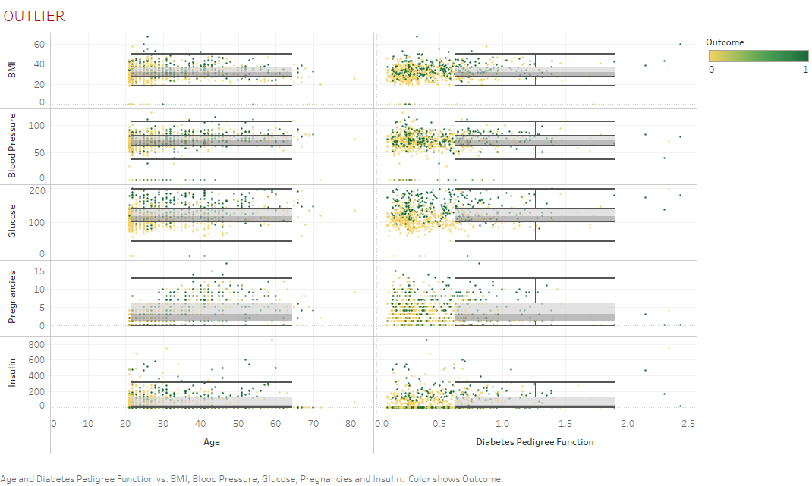
Outliers

Slide 28
Data Preparation
Here are several ways to handle invalid data values :
Ignore/remove these cases : This is not actually possible in most cases because that would mean losing valuable information. And in this case “skin thickness” and “insulin” columns have a lot of invalid points. But it might work for “BMI”, “glucose ”and “blood pressure” data points
Put average/mean values : This might work for some datasets, but in our case putting a mean value to the blood pressure column would send a wrong signal to the model
Avoid using features : It is possible to not use the features with a lot of invalid values for the model. This may work for “skin thickness” but its hard to predict that
In this case, we will remove the rows which the “Blood Pressure”, “BMI” and “Glucose” are zero but will not work on any other outliers as this is a sample set.

Slide 29
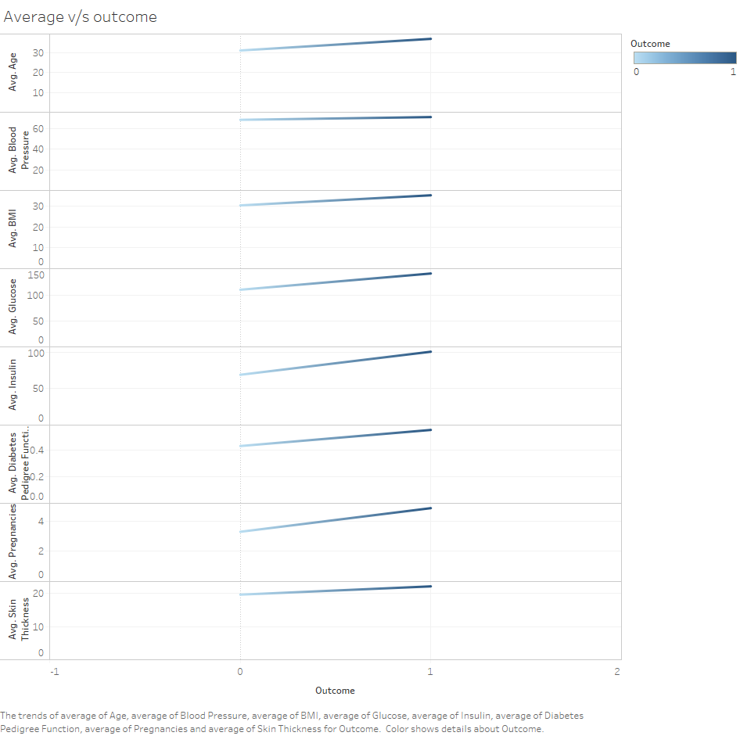
Average w.r.t outcome

Slide 30
Data Discovery
Scatter plots were used to do further analyze of the data to understand which attributes are directly related to the outcome
Reviewing scatter plots of all attributes in the dataset shows that:
There is no obvious relationship between age and onset of diabetes
There is no obvious relationship between pedigree function and onset of diabetes
This may suggest that diabetes is not hereditary, or that the Diabetes Pedigree Function needs work
Larger values of Glucose combined with larger values for age, pedigree, BMI, insulin, skin thickness, BP, and pregnancies tends to show greater likelihood of testing positive for diabetes

Slide 31
Conclusion
From the plots we get to see the following Results:
With the increasing age the level of insulin decreases because beta-cell production in the body the decreases, and the intake of insulin from outside increases (as shown in the above table), and the level of glucose increases so the person is more likely to be diabetic
The skin thickness also decreases with aging and we understand that this is also a factor which is more likely to contribute to diabetes
The number of Pregnancies is affected by the factor DPF and with increase in the number of pregnancies, the future kids are more likely to be diabetic

